Slide 1
University of Arizona MS DS Cohort-3
Title : CAPSTONE PROJECT-1
Project Name : FINANCE AND RISK ANALYTICS
Submitted by : ARNAV MUNSHI
Date of Submission : 14th May 2023

Slide 2
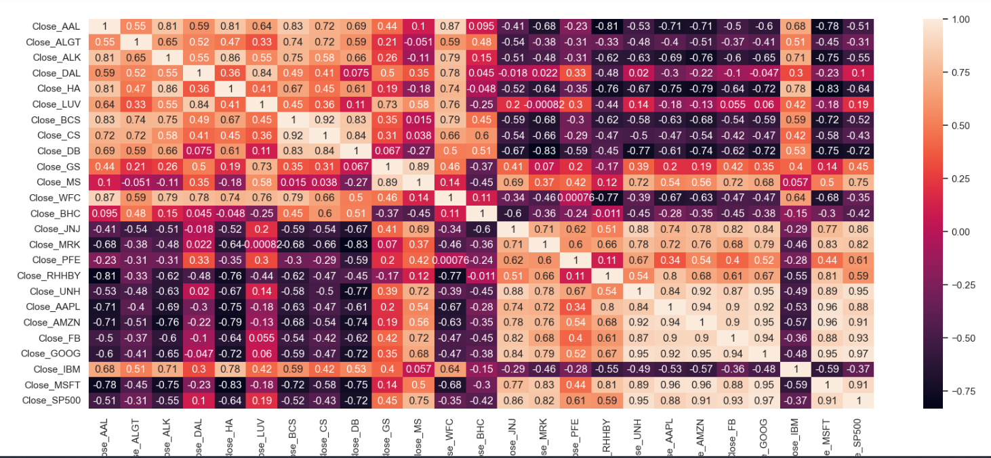
Heatmap created for Stock Prices
Analysis:
1. Strong Positive Correlation (0.6 to 1): Apple, Amazon, Google, Goldman Sachs, J&J, Merck & Co
2. Weak Positive Correlation (0 to 0.6): American Airlines, Alaska Air, Hawaiian Holdings.
3. Negative Correlation (0 to -1): Bausch Health, Credit Suisse, Deutsche Bank.

Slide 3
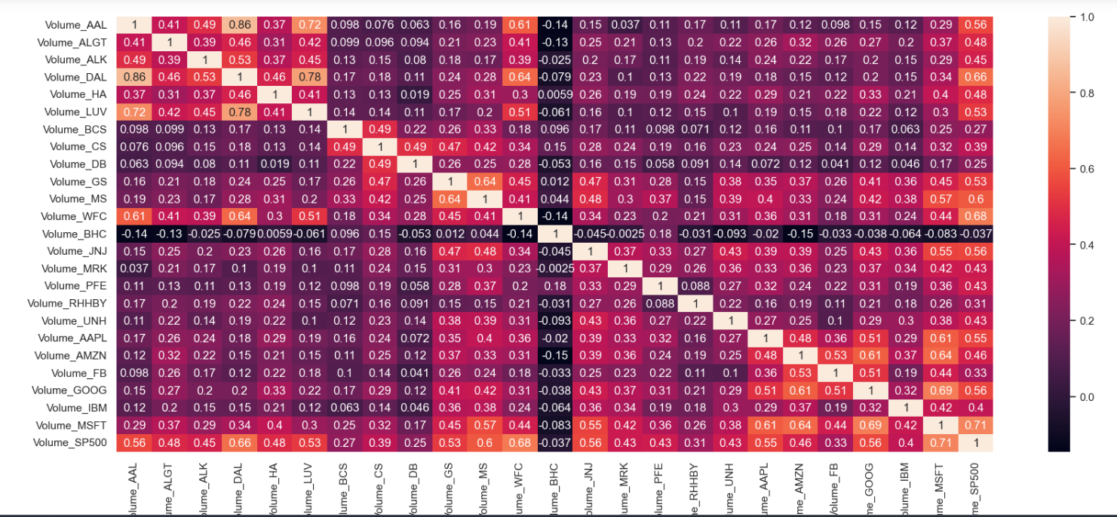
Heatmap for Stock Volume
Analysis:
S&P500 has a positve correlation with all the stock except with BHC
Correlation of more than 0.6 can be observed in the volumes of DAL, WFC, MS, and the highest is with MSFT - 0.71.

Slide 4
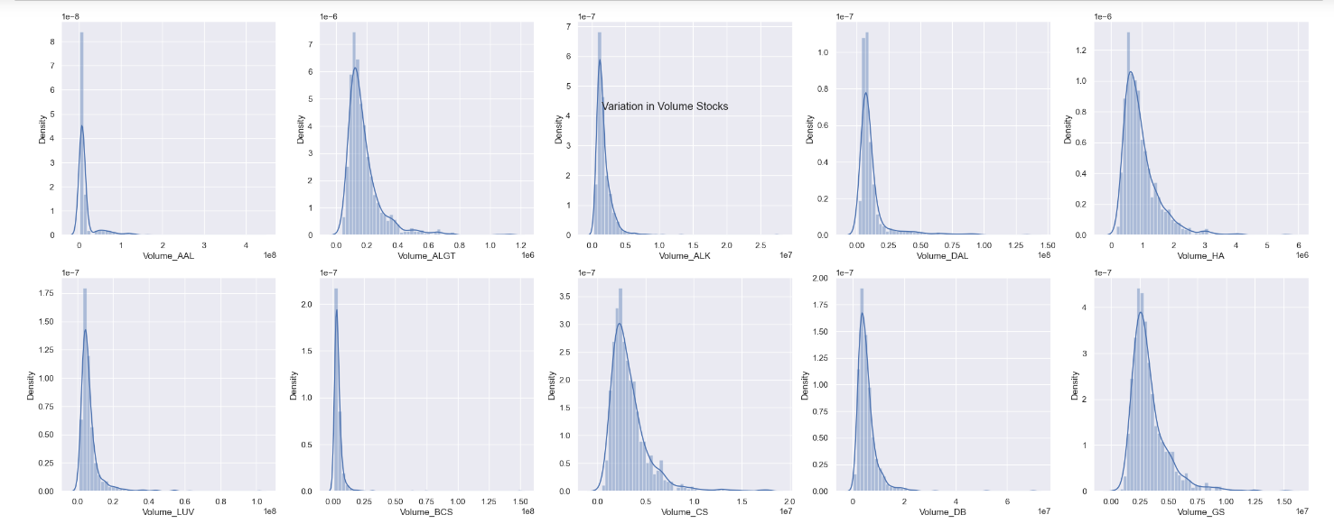
Histogram plots for Stock Volume
Analysis:
Higher the standard deviation we have , more volatile our stocks will be.
ALGT, DAL, HA, CS, GS, MS, WFC, BHC, RHBY, AAPL, GOOG, IBM are the companies for which we have seen volatility in stocks

Slide 5
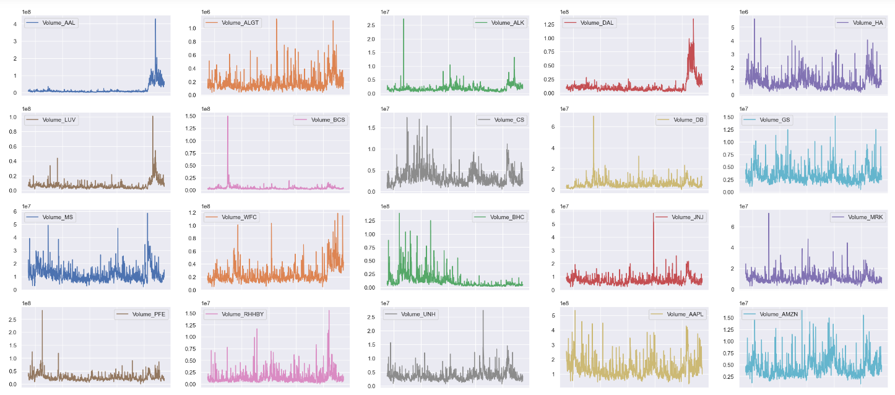
Sub plots for Stock Volume
Analysis:
For the companies like AAPL , DAL and LUV , the stocks have gone high in the year range of 2019-2020. But for BCS,DB , JNJ and PFE stocks volume were not high.

Slide 6
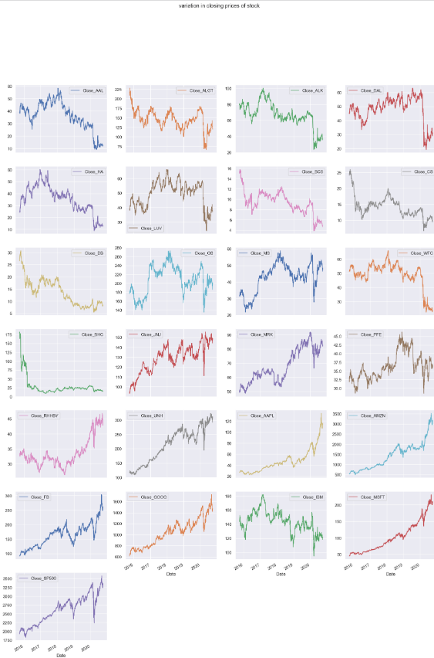
Variations in Closing prices of Stock
Analysis:
Prices are to show an upward trend in the future
Prices were dropped in DB and BHC

Slide 7
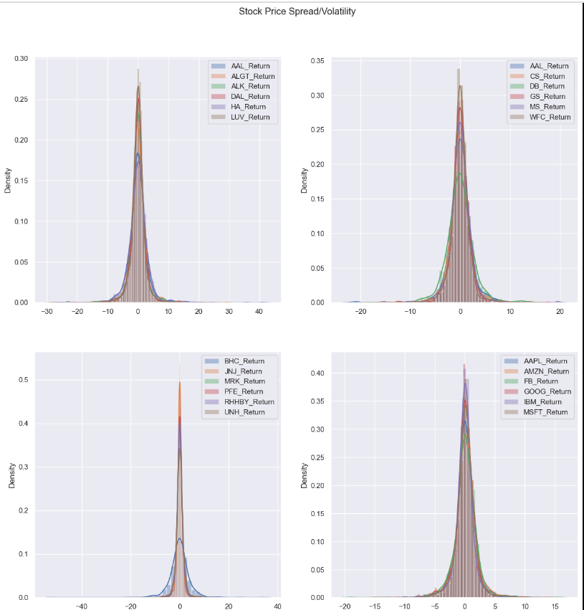
Stock Prices spread/volatility

Slide 8
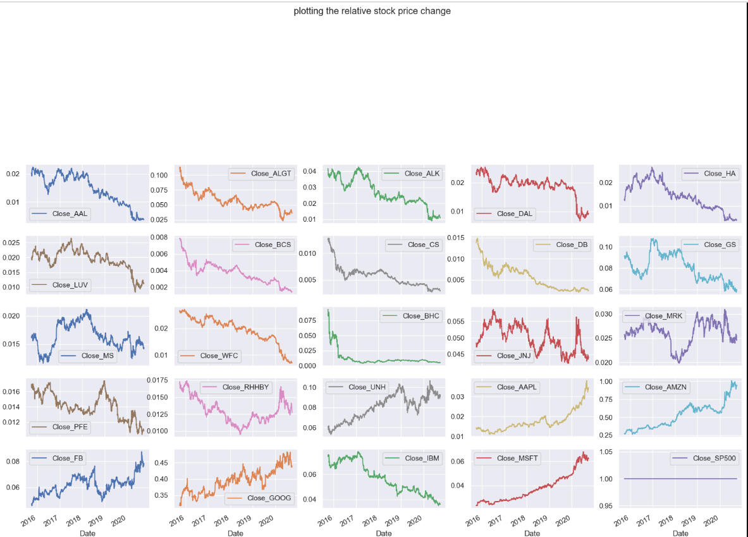
Relative Stock price change

Slide 9
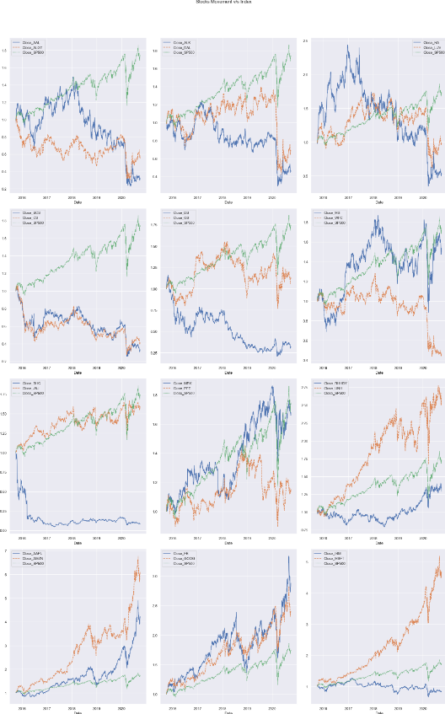
Stock movement v/s Index
Analysis:
MSFT< GOOG, FB, AAPL, AMZN are showing an uptrend, whereas IBM is showing a downtrend.
In healthcare - BHC and PFE are showing a downtrend
In Finance - DB, BCS, CS and WFC are showing a downtrend
In avaiation - HA, DAL, AAL are showing a downtrend.

